Slide 1
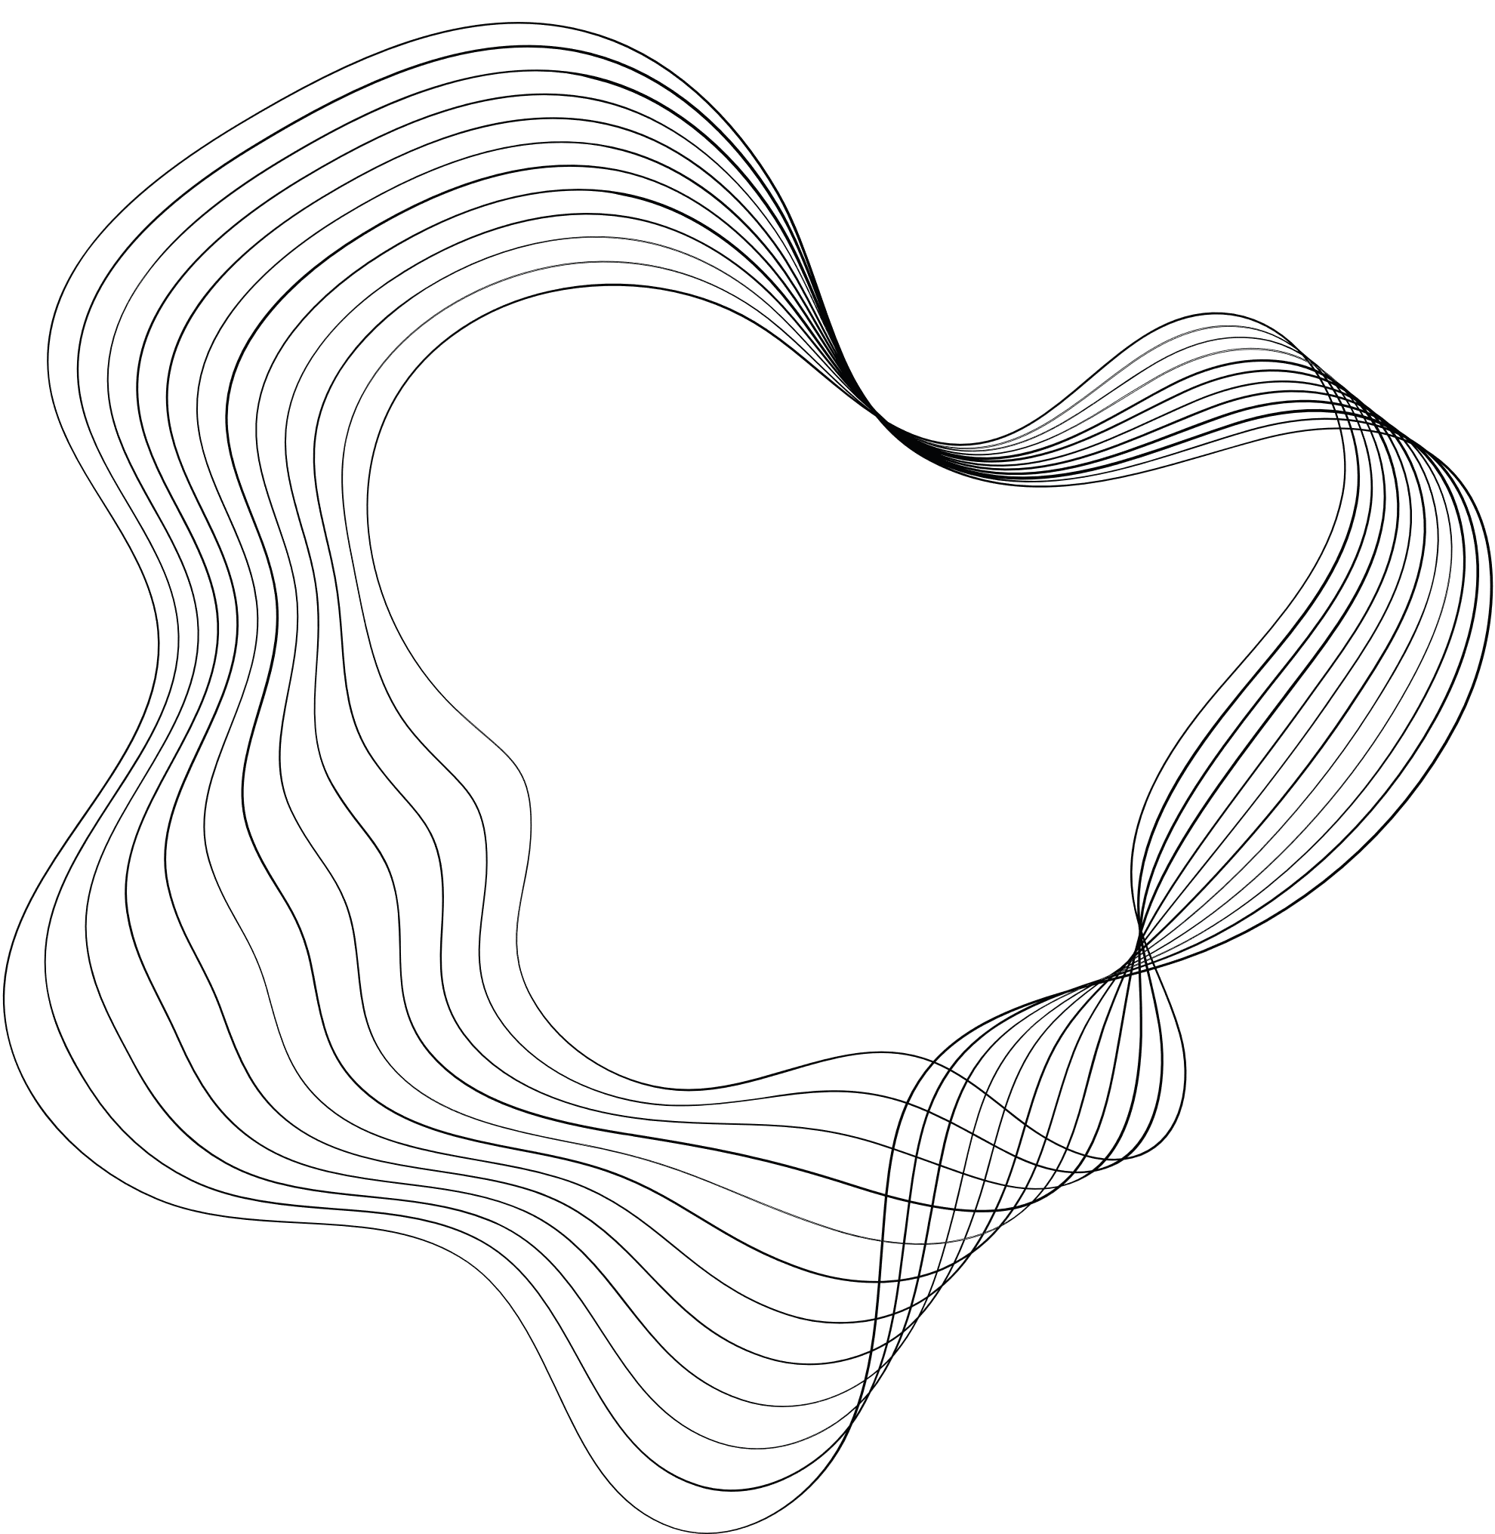

FLIP SORT 10327 & DARK ROADS 11631

Slide 2



Mr. Jargis Ahme
Teacher By
Assistant Professor & PC(D)
Department Of CSE
Green University of Bangladesh
Saifulla Tanim
STUDENT BY
222002014
Department Of CSE
Green University of Bangladesh

Slide 3
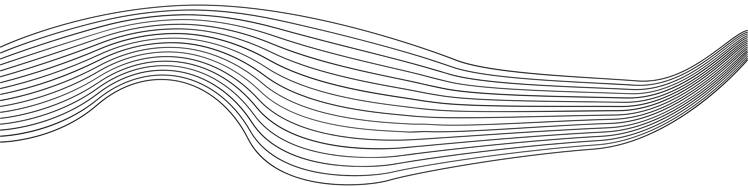
CONTENT
PROBLEM 1
PROBLEM 2
01
INTRODUCTION
01
INTRODUCTION
02
ALGORITHM PSEUDOCODE
02
ALGORITHM PSEUDOCODE
03
SIMULATION
03
SIMULATION
04
IMPLEMENTATION SCREENSHOT
04
IMPLEMENTATION SCREENSHOT
05
INPUT/OUTPUT
05
INPUT/OUTPUT
06
UVA - SCREENSHOT
06
UVA - 11631 SCREENSHOT

Slide 4

PROBLEM 1

Slide 5




INTRODUCTION
Sorting is a fundamental operation in computer science for organizing data. This problem focuses on finding the minimum number of flips required to sort an array in ascending order using the Bubble Sort algorithm. Each flip corresponds to a swap of two adjacent elements in the wrong order. This task helps demonstrate the computational steps involved in sorting and the efficiency of the algorithm in terms of operations.

Slide 6

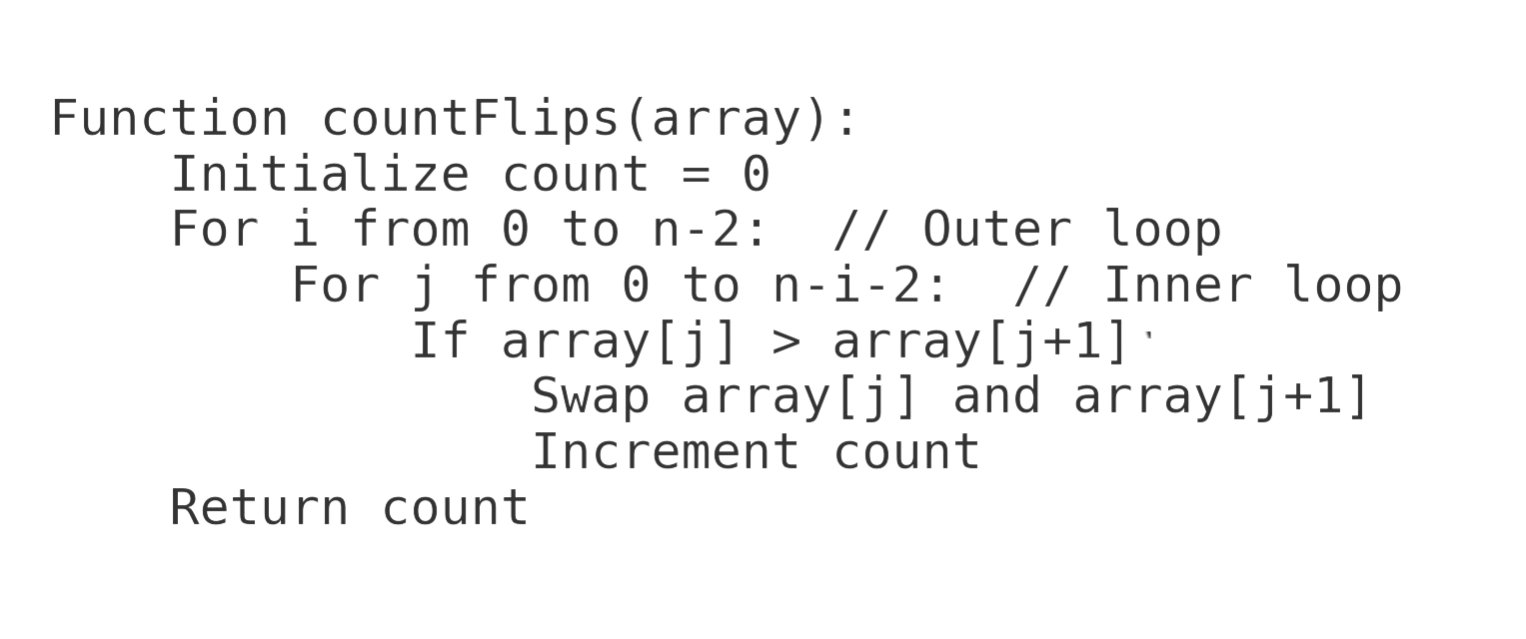
ALGORITHM PSEUDOCODE

Slide 7

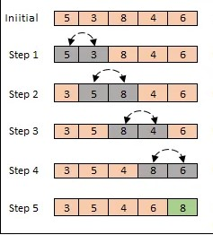
SIMULATION

Slide 8

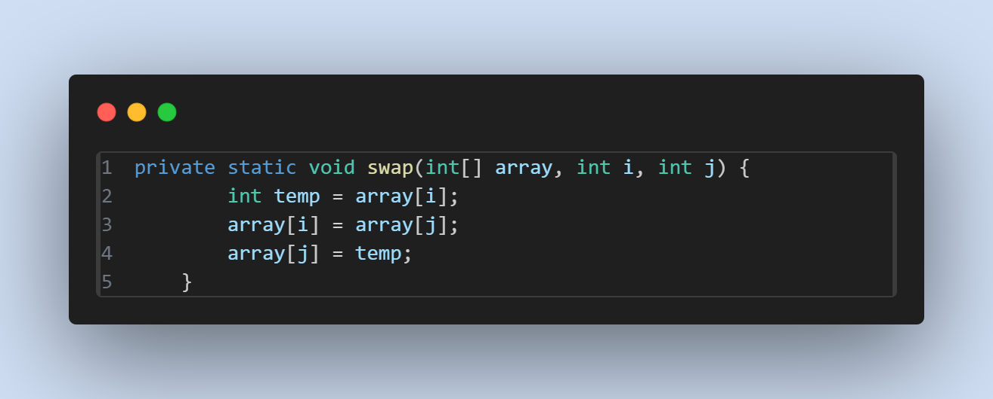
IMPLEMENTATION SCREENSHOT
READS THE ARRAY

Slide 9
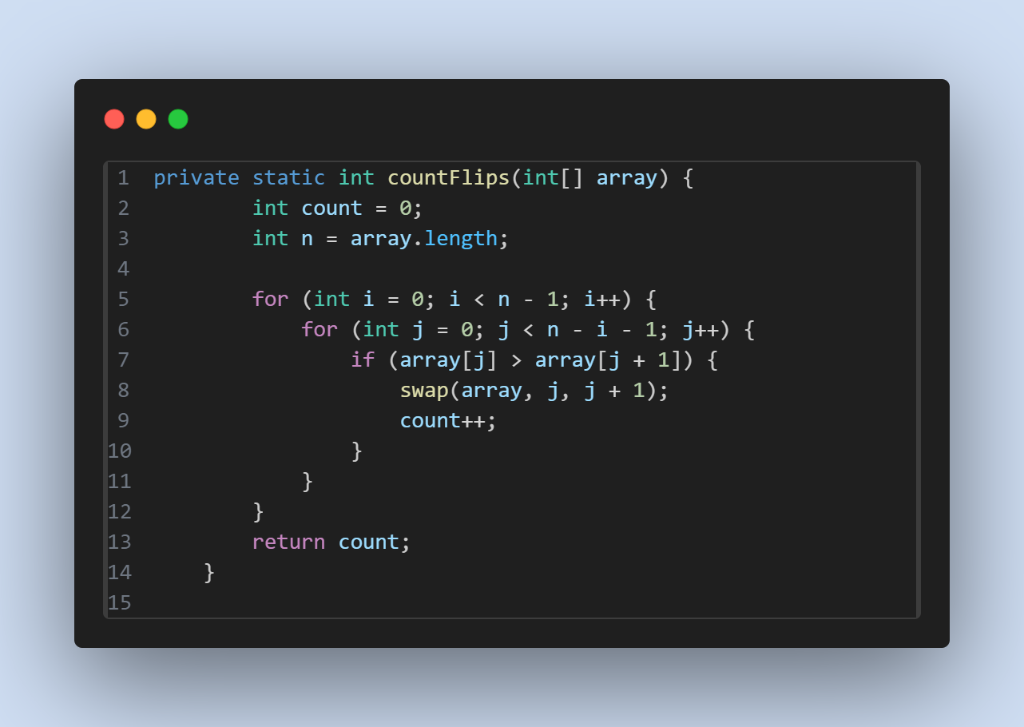
IMPLEMENTATION SCREENSHOT
COUNTS FLIPS USING BUBBLE SORT

Slide 10
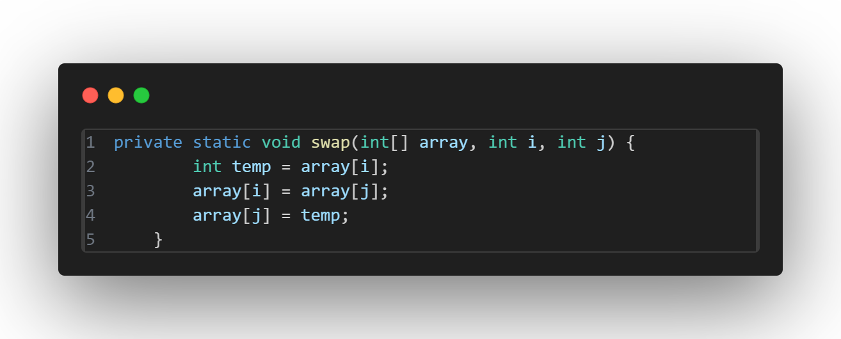
IMPLEMENTATION SCREENSHOT
SWAPS TWO ELEMENTS

Slide 11
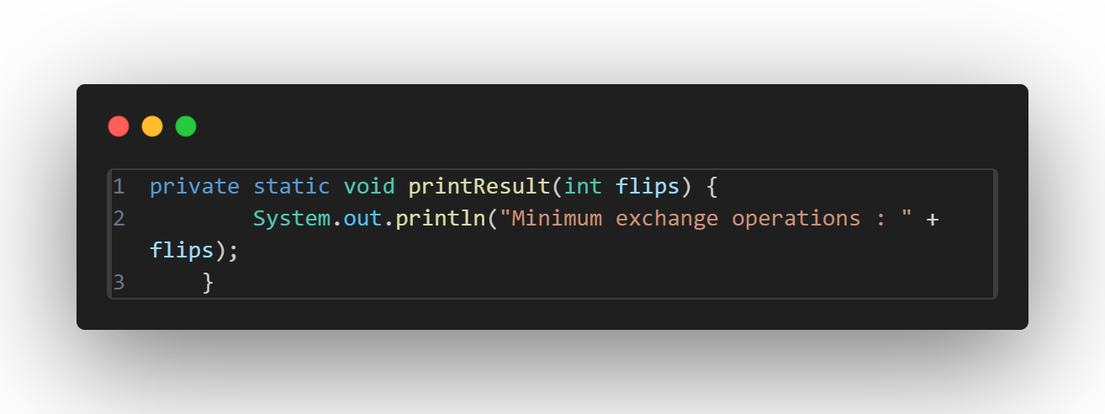
IMPLEMENTATION SCREENSHOT
PRINTS THE RESULT

Slide 12

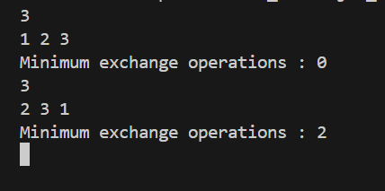

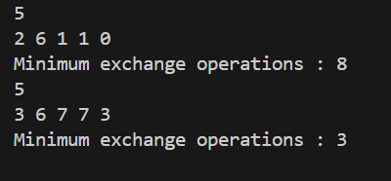
01
Sample input/output
02
extra sample input

Slide 13
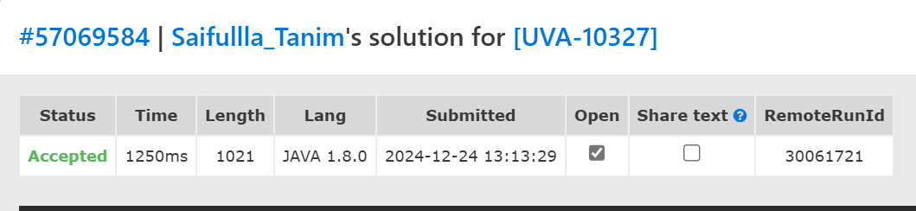
IMPLEMENTATION SCREENSHOT
PROBLEM 1 (UVA - 10327)

Slide 14
PROBLEM 2

Slide 15
INTRODUCTION
The problem involves finding the weight of edges not included in the Minimum Spanning Tree (MST) of a weighted graph. Using Kruskal's algorithm and Union-Find, the MST is constructed by sorting edges by weight and avoiding cycles. The solution calculates the total weight of the graph, the MST weight, and their difference, highlighting applications in network optimization.

Slide 16
ALGORITHM PSEUDOCODE
Algorithm Kruskal(graph)
Input: A list of edges and number of vertices (m, n)
Output: Weight of edges not included in the MST
Initialize totalWeight = 0
Initialize parent[] and rank[] arrays for Union-Find
For each edge (u, v, weight) in the graph:
Add weight to totalWeight
Add edge to the edge list
Sort edges by weight
Initialize mstWeight = 0
For each edge (u, v, weight) in sorted edge list:
If find(parent, u) != find(parent, v):
Add weight to mstWeight
union(parent, rank, u, v)
Return totalWeight - mstWeight

Slide 17
SIMULATION
Graph with 4 vertices (0, 1, 2, 3) and 5 edges.
Edges: (0-1: 4), (0-2: 1), (1-2: 3), (1-3: 2), (2-3: 5)
Step 1: Total weight = 4+1+3+2+5=154 + 1 + 3 + 2 + 5 = 154+1+3+2+5=15
Step 2: Sort edges by weight: (0-2: 1), (1-3: 2), (1-2: 3), (0-1: 4), (2-3: 5)
Step 3: Apply Kruskal’s algorithm:
Add (0-2: 1) → MST weight = 1
Add (1-3: 2) → MST weight = 3
Add (1-2: 3) → MST weight = 6
Step 4: Non-MST weight = Total weight - MST weight = 15−6=915 - 6 = 915−6=9

Slide 18
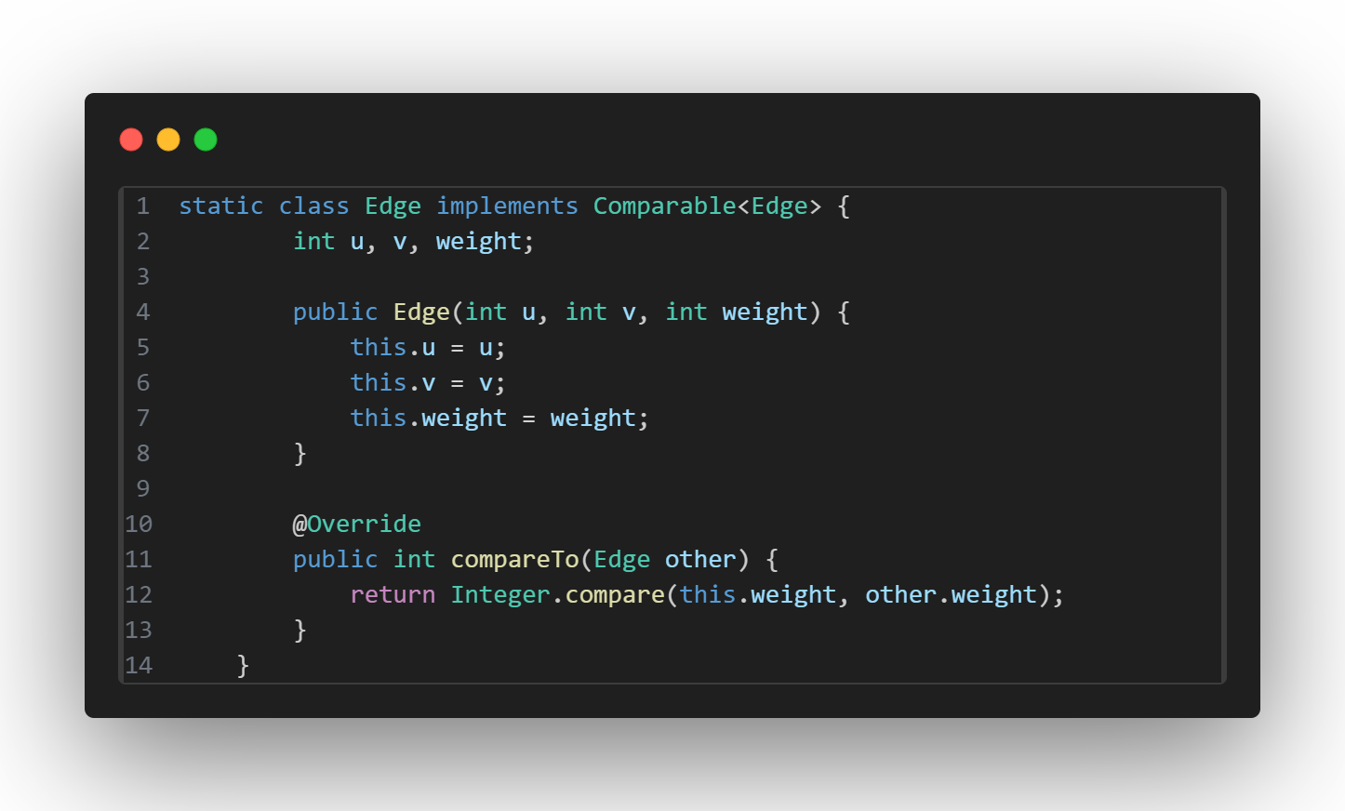
IMPLEMENTATION SCREENSHOT
CLASS TO REPRESENT AN EDGE WITH ENDPOINTS AND WEIGHT

Slide 19
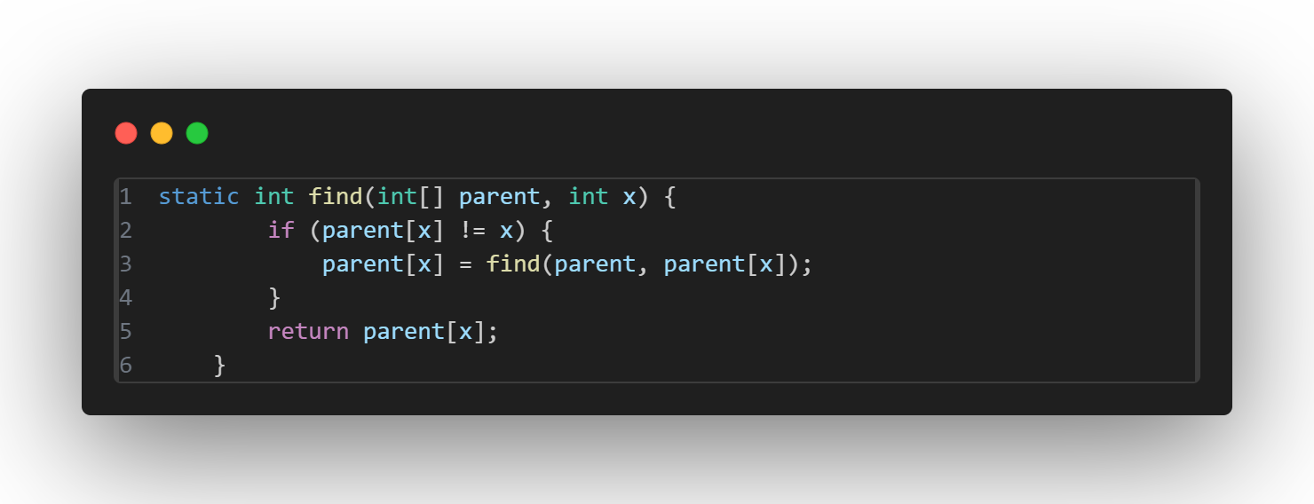
IMPLEMENTATION SCREENSHOT
FUNCTION TO FIND THE ROOT OF A NODE IN THE UNION-FIND STRUCTURE

Slide 20
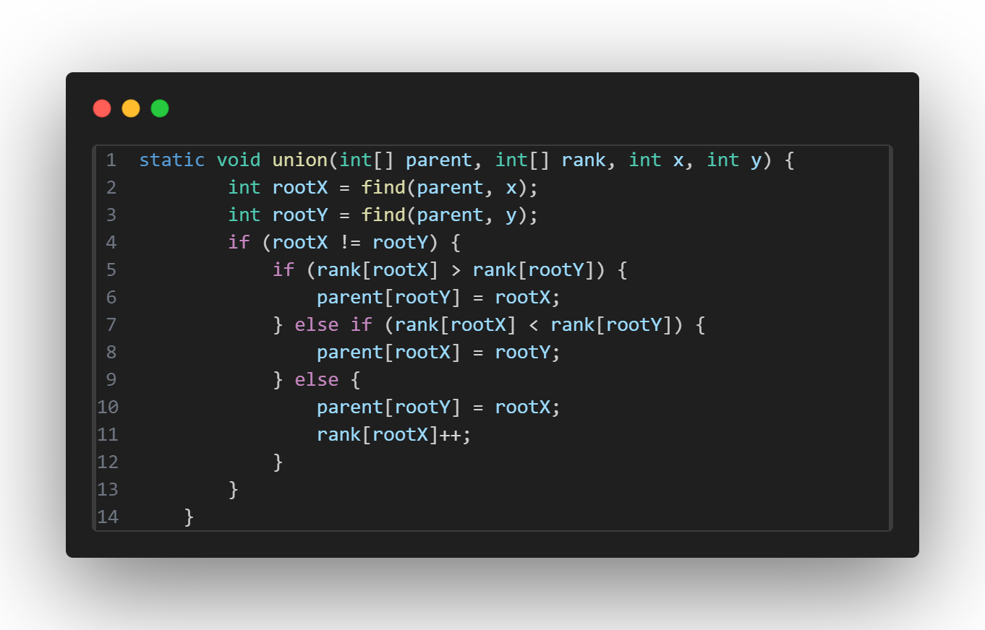
IMPLEMENTATION SCREENSHOT
FUNCTION TO PERFORM UNION OPERATION IN UNION-FIND

Slide 21
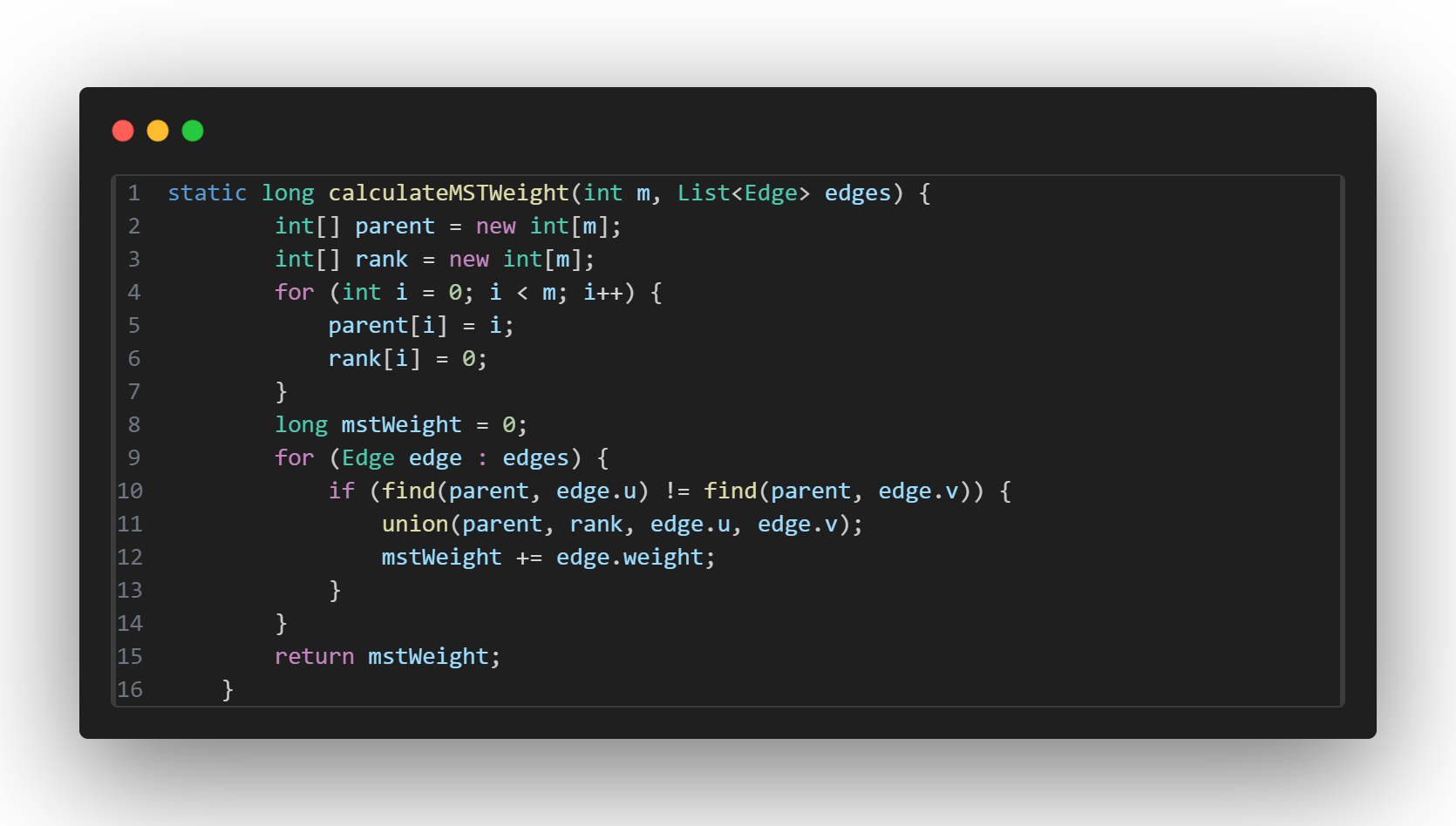
IMPLEMENTATION SCREENSHOT
FUNCTION TO CALCULATE THE MST WEIGHT USING KRUSKAL'S ALGORITHM

Slide 22

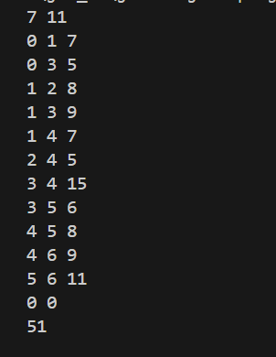
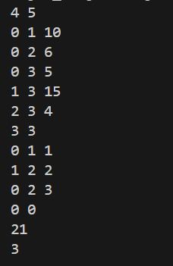
SAMPLE INPUT/OUTPUT
EXTRA SAMPLE INPUT

Slide 23
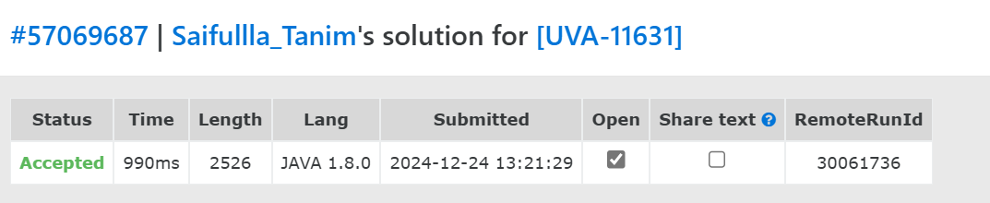
IMPLEMENTATION SCREENSHOT
PROBLEM 2 (UVA - 11631)

Slide 24
THANK YOU

